Slide 1


Discovery BPA
Evaluations
Accelerating IT Modernization
What we learned from our evaluation process.
Presented by: Centers of Excellence Acquisition Team

Slide 2

Accelerating IT Modernization
Overview
The GSA Centers of Excellence (CoE) was established to accelerate IT modernization across Government in order to improve the public experience and increase operational efficiency. When partnering with an agency, the first step to a successful effort is discovery and assessment work.
To satisfy the program-level need to provide such services to multiple agencies at once, CoE partnered with Region 1 AAS (R01) to issue the Discovery BPA, focusing on seven functional areas:
Change Management | Cloud Adoption | Contact Center | Customer Experience | Data Analytics Information Security | Infrastructure Optimization

Slide 3
Accelerating IT Modernization
The Discovery BPA evaluation process was designed to allow contractors to emphasize their technical expertise through a phased approach that was streamlined and objective.

Slide 4
GSA Centers of Excellence
Accelerating IT Modernization
Overview
Highlights
We had a great deal of engagement as a result of the press surrounding this project, leading to an incredible response rate from a broad section of industry.
315 questions during Q&A
90 + total vendor submissions
53% made it to the Second Phase
52% made it to the Third Phase
Small businesses make up nearly a third of the new and established companies among the 22 that became BPA holders

Slide 5

Accelerating IT Modernization
The Process
Collaboration was key
Without the teamwork between R01 and CoE (as well as our colleagues from 18F Acquisitions, who supported us along the way), this evaluation process would not be what it was.
The same is true for the feedback we received from industry through our RFI, during which we posted a draft RFQ.

Slide 6
GSA Centers of Excellence
Accelerating IT Modernization
The Process
How it came to be
The original evaluation process was a familiar one to many in that a response would consist of two parts:
Part 1 would be the technical volume, including the technical and management approaches; and,
Part 2 would be a pricing volume.
Feedback from our RFI, especially from small businesses, indicated that in order to attract new-to-government as well as small businesses, this wasn’t going to work for us. In particular, it was noted that this wouldn’t permit them to demonstrate their technical capabilities in a way that would be effective or useful to evaluators.

Slide 7
GSA Centers of Excellence
Accelerating IT Modernization
The Process
Changes made
The teams spent time reflecting upon what our industry partners told us in the RFI and what we knew from previous procurements. We also took into account the expected volume of responses, the workload this would place on ourselves and our evaluators, and the objective of truly finding best-in-class technical partners.
The result was a new evaluation process broken up into three phases (with pricing evaluation limited to determining if a discount against schedule rates was provided):
First phase: a technical challenge
Second phase: a scenario question
Third phase: the technical volume, consisting of technical and management approach as well as similar experience (rather than past experience)

Slide 8
GSA Centers of Excellence
Accelerating IT Modernization
The Process
Lessons learned
The new evaluation process was a great success! The key takeaways from the development of this process were as follows:
A draft RFQ with your RFI will allow you to get industry feedback on every aspect of your solicitation, including the way in which you’ll select contractors, giving you data on what the process itself will do to your response pool.
Technical challenges and similar one-page or less questions, developed by the evaluators themselves, gives all contractors an equal playing field and encourage participation from those with the best technical capabilities.
The use of Google Forms for evaluations gave the acquisition team additional tools and capabilities when sharing information with evaluators and preparing award documentation.

Slide 9
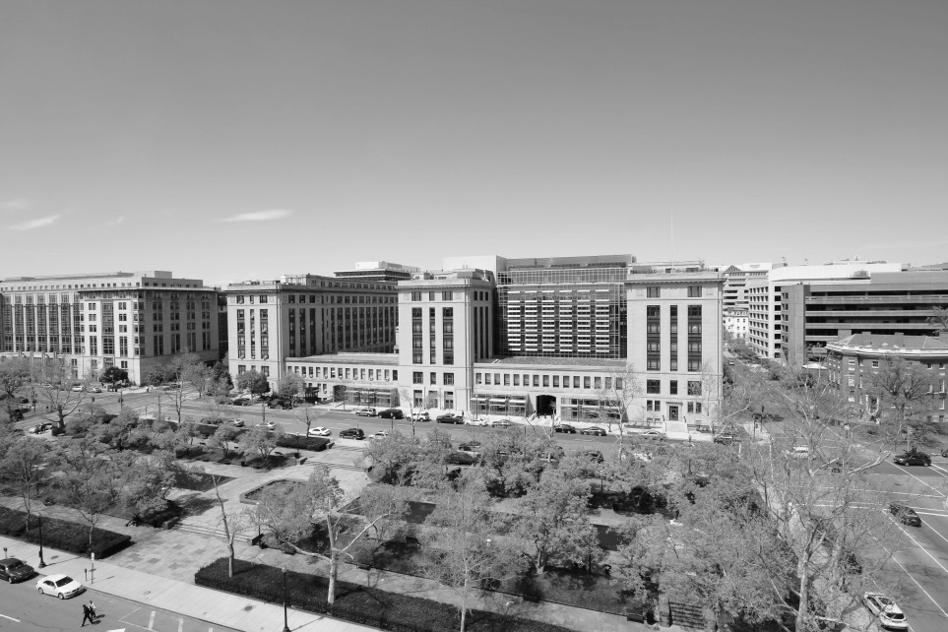
Accelerating IT Modernization
The Evaluation
Everyone played their part
The team’s roles and responsibilities were clearly delineated among the integrated project team. This process required the following roles:
Acquisition team
CO, PM, Acquisition SME
Technical SMEs
Evaluator, Advisor(s)

Slide 10
GSA Centers of Excellence
Accelerating IT Modernization
The Evaluation
What we did
The evaluation kickoff was only the first of many meetings between the acquisition team and the technical SMEs. Constant communication allowed for quality justifications.
The team held a kickoff for each phase which included an outline of each step of the process, how long it would take, and how responses would be submitted.
The acquisition team made themselves available at any time of the day to assist evaluators in drafting their justifications.
Evaluators justifications - once submitted - were reviewed not only for their strength, but consistency across responses, ensuring objectivity.

Slide 11
GSA Centers of Excellence
Accelerating IT Modernization
The Evaluation
What went well
Three things we intend to incorporate into future procurements, when feasible:
Provide Google Forms for evaluators to submit their responses, allowing for a standard and consistent response format, making it easier for the acquisition team to review responses and copy/paste them as needed.
Create a “Mad Libs” style answer guide structure for evaluators to follow, allowing them to focus their evaluations on the aspects of the responses most important to the evaluation itself and providing the acquisition team the ability to obtain justifications that didn’t require follow ups for more information.
Use a team of technical experts from the project itself as evaluators, ensuring they are dedicated to the process and truly invested in finding the best fit.

Slide 12
GSA Centers of Excellence
Accelerating IT Modernization
Overall
Lessons learned
Whether you want to replicate our process or you want to modify it to fit your circumstances, there are a few things worth thinking about:
Brief explanation letter
Ask for CTA in response so you don’t have to sift through to find it
Have time to send and collect NDAs built in

Slide 13
GSA Centers of Excellence
Accelerating IT Modernization
The Evaluation
Lessons learned
In order to make sure our evaluators were able to successfully complete their evaluations while managing their day-to-day work, the following steps were key:
Eliminating technically unacceptable contractors at the start provides the evaluator and acquisition teams the ability to focus and avoid fatigue.
Ensuring evaluator’s supervisors understand the workload being placed on the individuals themselves so that they can prioritize the evaluation over their usual activities and find the best contractor for the requirements is an investment in the long term success of the project.
The tighter the timelines, the greater the expertise required from the individuals on the team, especially as the justifications will form the basis of the brief explanation letters being sent to unsuccessful contractors.

Slide 14

Thank
you.
Accelerating IT Modernization
Centers of Excellence
https://coe.gsa.gov/

